Slide 1
Web technology workshop Day 12

Slide 2
DATA TYPES
SYMBOL
BIGINT

Slide 3
THE Web is a hypertext information sysytem
Instead of reading text in a rigid ,linear structure (such as reading book),
You can skip easily from one point to another, you can get information ,
Go back , jumps to other topics , and navigate through the text based on
What interests you at the time.
THE Web is CROSS-PLATFORM
You can access the internet / web, regardless of whether you working on a
Smartphone , a tablet , a brand new laptop ,or a desktop computer.
You can access web information equally well from any computer running any
Operating system using any display

Slide 4
THE Web is dISTRIBUTED
Web content have huge storage in the forms of images , audio ,videos..etc,
So, it’s impossible to store at one place.
Web provide so much information because that information is distributed
globally across millions of websites, each of which contributes the space for the
information it publishes. These sites reside on one or more computers, referred to as web
servers.
THE Web is dynamic
If you’re publishing on the Web, you can make sure that your information is up-to- date all the time.
If you want a permanent copy of some information that’s stored on the Web, you have to save it locally because the content can change any time, even while you’re viewing the page.

Slide 5
THE Web is Interactive
Interactivity is the capability to “talk back” to the web server.
More traditional media , such as television, isn’t interactive in the slightest;
all you do is sit and watch as shows are played at you. Other than changing the channel, you don’t have much control over what you see.
SOCIAL MEDIA

Slide 6
WEB PUBLISHING
Web publishing mean creating web pages as individual files and uploading them to a server so that people could view them in their browsers.

Slide 7
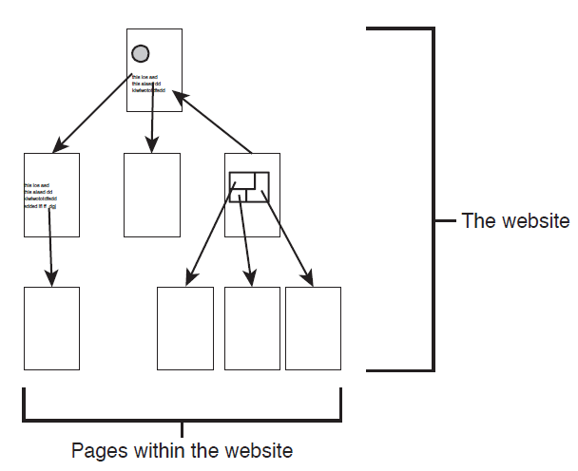
ANATOMY OF A WEBSITE
Website :
A collection of one or more web pages linked together in a meaningful way that, as a whole, describes a body of information or creates an overall effect.

Slide 8
Web server— A computer on the Internet or an intranet that delivers web pages and other files in response to browser requests.
Web page—A single document on a website, usually consisting of a Hypertext Markup Language (HTML) document and any items that are displayed within that document, such as inline images or style sheets.
Home page— The entry page for a website, which can link to additional pages on the same website or pages on other sites.

Slide 9
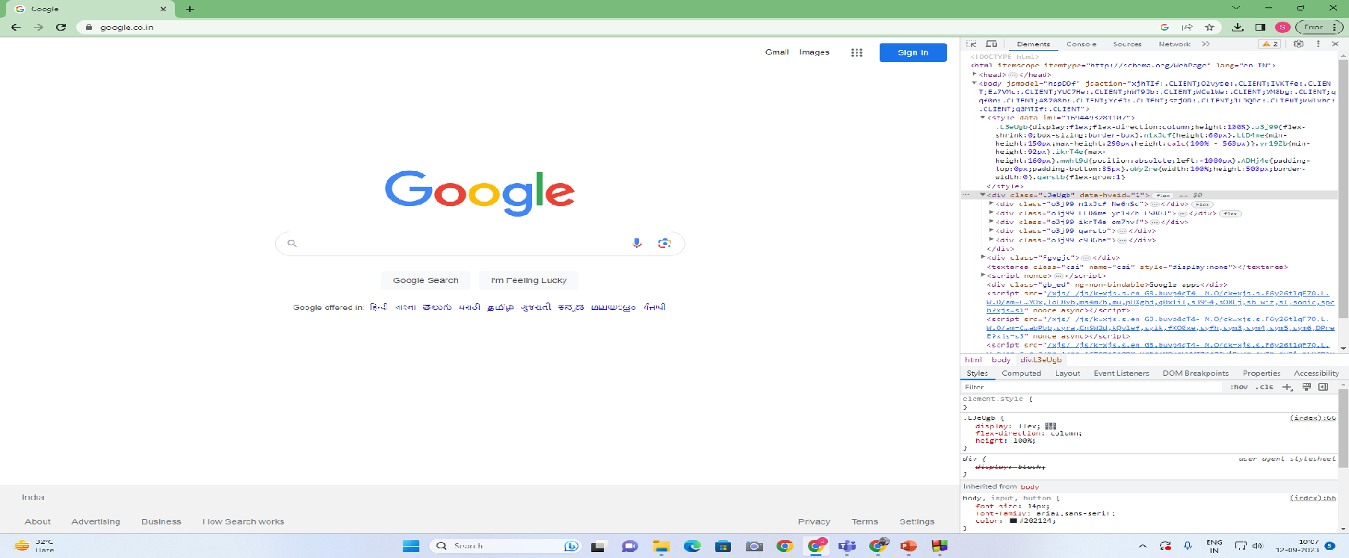
Developer tools
Programs that allow a developer to create, test and debug software.
Go to
www.google.com

Slide 10
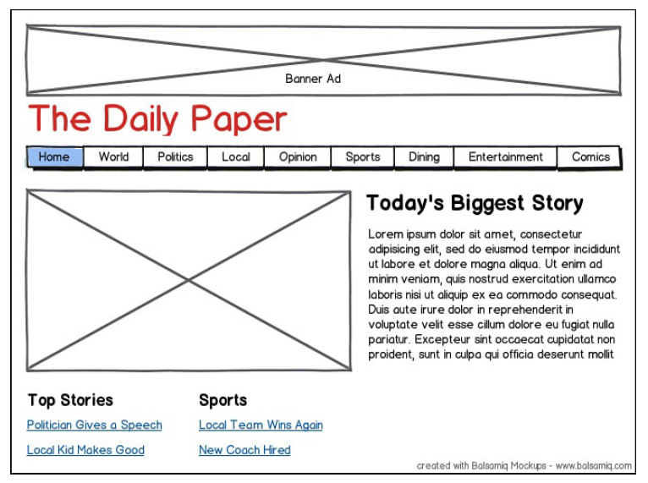
Wire framing
Wireframes provides a rough outline of what the website will look like when it’s done , showing which content will appear on which pages and how they will be connected together.

Slide 11
Keep in mind while wireframing
Which topics will go on each page?
how much information to put on one page
What are the primary forms of navigation between pages?
What links will you need for your visitors to navigate from page to page
What alternative forms of navigation are you going to provide?
Extra forms of information when designing your plan, and think about how you’re
going to link them into the main content.
What will you put on your home page?
Home page is the starting point for the rest of the information in your website, consider
what sort of information you’re going to put on the home page. A blog? A general summary of what’s
to come? A list of links to other topics?
What are your goals?
Make sure that you aren’t obscuring your goals with extra information or content.

Slide 12
Web hosting
Web hosting is a service companies provide that allows you to make your website visible and accessible. Rather than hosting your website on your own network server, you rent space on a provider’s — this ensures maximum speed, reliability and security for your website.
Using a Content-Management Application
if you want to publish a blog, you can use sites like TypePad (http://typepad.com/), Blogger (http://blogger.com), WordPress (http://wordpress.com/), or
Tumblr (http://tumblr.com), among many others. The advantage of these applications is
that it’s easy to set up a site, pick a theme, and start publishing content on the Web through
a web interface. There’s no need to build the web pages by hand, set up a hosting account,
or even deal with editing files by hand.

Slide 13
Steps in web hosting
1.Register a domain name. If you want your website to appear at a URL
like mycoolsite.com or mycompany.com
2. There are a huge number of hosting companies that provide web space to people who want to launch their own websites. Companies like DreamHost (http://dreamhost.com/) and Pair.com(http://pair.com/)and sign up for an account. If you’re going to be putting your pages on an internal or external server belonging to your employer or your school, you won’t need your own hosting. But if you’re creating a new website that will be available on the Internet, you’ll need some sort of hosting arrangement.
3.Associate your domain name with your new website, if you have registered one.
Your domain registrar and hosting company should provide instructions for setting it
up so that your domain name points to your hosting account. That way when users
enter your domain name in a URL, they’ll get the content that you upload to your
server.
4.Start uploading your content. Once your web hosting is set up, you can use
whatever tool you prefer to start uploading web content to the server. Many hosts
provide a web interface that will allow you to upload content, but most hosts will
also let you use a file transfer tool that supports File Transfer Protocol (FTP), Secure
Copy (SCP), or Secure FTP (SFTP) to get your files to the server.

Slide 14
INTRO TO HTML
HTML stands for Hypertext Markup Language.
HTML Describes the Structure of a Page.
HTML Does Not Describe Page Layout.
HTML is a markup language. Writing in a markup language means that you start with the text of your page and add special tags around words and paragraphs. The tags indicate the different parts of the page and produce different effects in the browser.
What HTML Files Look Like:
The text of the page itself
HTML tags that identify page elements, structure, formatting, and hypertext links to other pages or to included media
<thetagname> text </thetagname>
Not all HTML tags have both an opening and a closing tag. Some tags are only one-side (img tag)

Slide 15
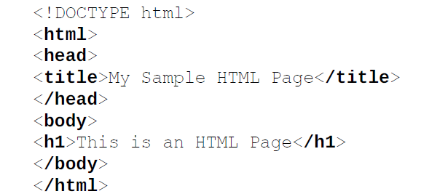
Continue….
HTML tags are not case sensitive; that is, you can specify them in uppercase, in
lowercase, or in any mixture. So, <HTML> is the same as <html>, which is the
same as <HtMl>.

Slide 16
<!DOCTYPE html> — doctype. It is a required preamble.
It begins with an exclamation point. The purpose of the DOCTYPE is to tell validators and browsers which specification your page was written to—in HTML.
<HTML></HTML>:
This element wraps all the content on the entire page and is sometimes known as the root element. It also includes the LANG attribute, setting the primary language of the document.
<HEAD></HEAD> :NOTHING SHOWS IN BROWSER BUT METADATA
This element acts as a container for all the stuff you want to include on the HTML page that isn't the content you are showing to your page's viewers. This includes things like keywords and a page description that you want to appear in search results, CSS to style our content, character set declarations, and more.

Slide 17
<meta charset="utf-8"> :
This element sets the character set your document should use to UTF-8 which includes most characters from the vast majority of written languages.
<title></title> :
This sets the title of your page, which is the title that appears in the browser tab the page is loaded in. It is also used to describe the page when you bookmark/favorite it.
<body></body> : This contains all the content that you want to show to web users when they visit your page, whether that's text, images, videos, games, playable audio tracks, or whatever else.

Slide 18
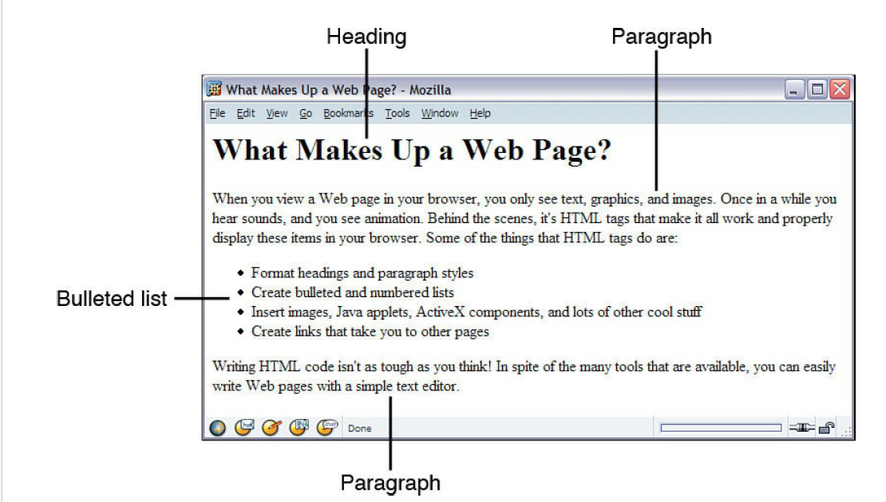

Slide 19
TEXT FORMATTING
When an HTML page is run by a browser, any formatting you might have done with whitespace characters—that is, any extra spaces, tabs, returns, and so on—is ignored.
Headings
Heading elements allow you to specify that certain parts of your content are headings — or subheadings. In the same way that a book has the main title, chapter titles, and subtitles, an HTML document can too. HTML contains 6 heading levels, <h1> - <h6>

Slide 20
HTML Attributes
HTML elements can be modified by attributes. Attributes are placed within the opening tag in an element.
Id Attributes contain extra information about the element that you want to appear in the actual content.
<h1 id=“theTopHeading”>Everything You Need to Know About HTML</h1>
The class attribute is another global attribute that can be used to establish arbitrary groups of elements. You can assign the same class to multiple elements so that they can be referenced as a group via CSS or JavaScript.
<h1 class=“headline” id=“leadstoryheadline”>Lead Story Headline</h1>
The third global attribute you’ll use a lot is style attribute.
<h1 style=“font-family: Verdana, sans-serif;”>Heading</h1>

